Slide 1
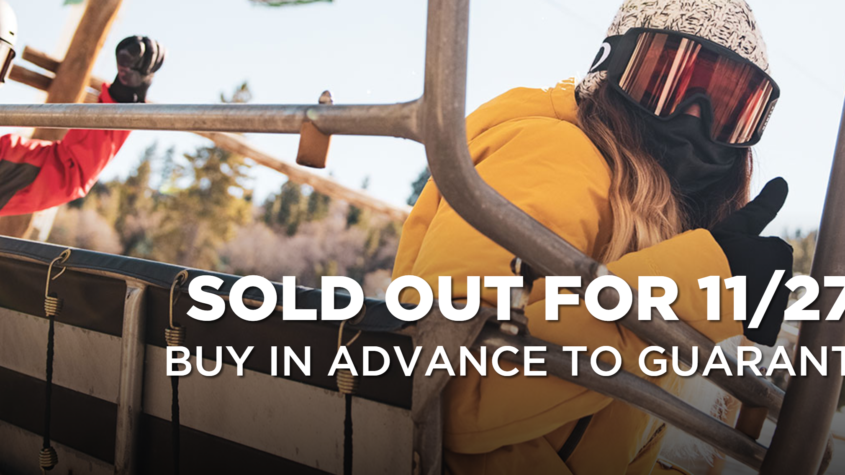
Big Mountain Resort
Ensieh Bahrami
Capstone Project 1

Slide 2
Problem Identification
Status Qua:
Installation of an additional chair lift increases operating costs by $1.54M
Return should support the future investment plans as before
The better value needs to be set as ticket price
Problem:
Which facilities matter most to visitors? particularly which facilities do visitors most likely pay more for?

Slide 3
Key Findings
About Montana:
Has fewer but larger resorts, one of top five states with large skiable area
Stands in 12th place in distribution of resorts by states
About Big Mountain:
Sits amongst all resorts for higher price
With the highest price in Montana
Quite a few resorts with a greater vertical drop
Very large snow making area
Among the resorts with the highest number of total chairs
With 3 fast quads but most resorts have no fast quads
High number of runs but some resorts with more, but not many
Has one of the longest runs (over half the length of the longest), the longer ones are rare.
Have no trams such as the vast majority of resorts

Slide 4
Best Simple Linear Regression Model
70-30 train-test split
Make a pipeline to
Impute train and test set with median since many features were skewed
StandardScaler each feature
Train simple linear regression model
Select a subset of features to remove overfitting problem in OLS model
Fit and cross validate the pipeline on train data with 5 folds to estimate model performance
Hyperparameter search using GridSearchCV
Cross validate the pipeline for multiple values of k to pick the number of features that gives the best performance

Slide 5
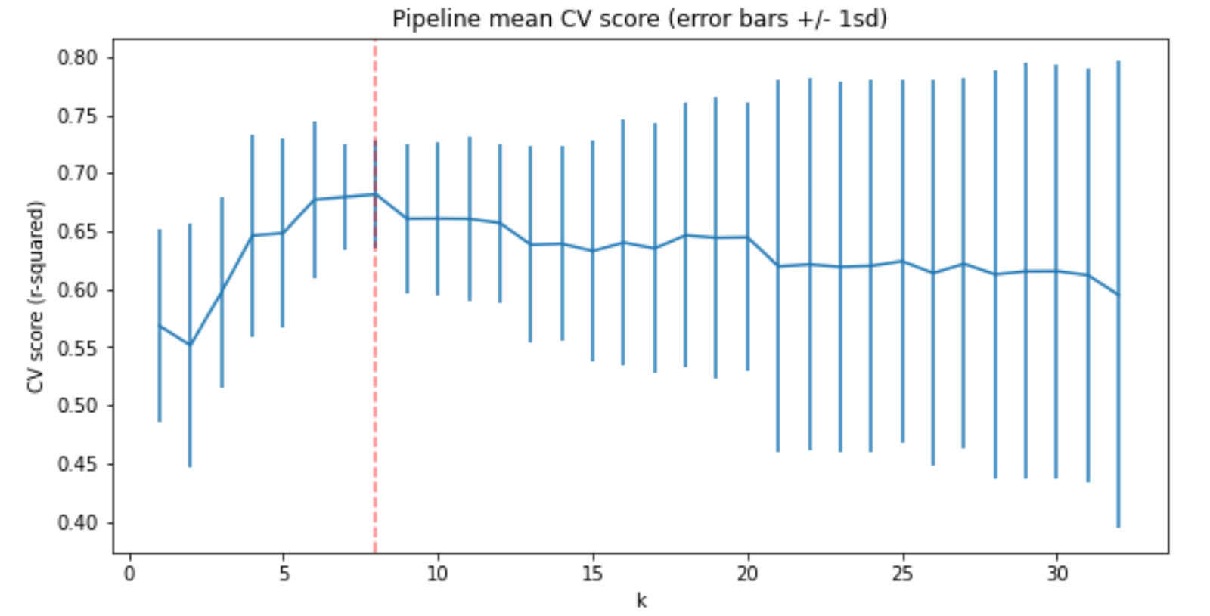
Best OLS Model Analysis
8 Selected Features | Coefficient
vertical_drop | 10.767857
Snow Making_ac | 6.290074
total_chairs | 5.794156
fastQuads | 5.745626
Runs | 5.370555
LongestRun_mi | 0.181814
trams | -4.142024
SkiableTerrain_ac | -5.249780
Vertical_drop and snow making equipment as the biggest strong positive features
Skiable terrain area negatively associated with ticket price!
larger resorts host more visitors at any one time, less charge per ticket

Slide 6
Best Random Forest Model
70-30 train-test split
Make a pipeline to
Impute train and test set with median since many features were skewed
StandardScaler each feature
Train Random Forest Regressor
Hyperparameter search by using GridSearchCV
Try RF regressor with and without feature scaling and try both the mean and median to impute missing values
Cross validate RF pipeline (fitting as part of CV process) with 5 folds to find model with the best performance

Slide 7
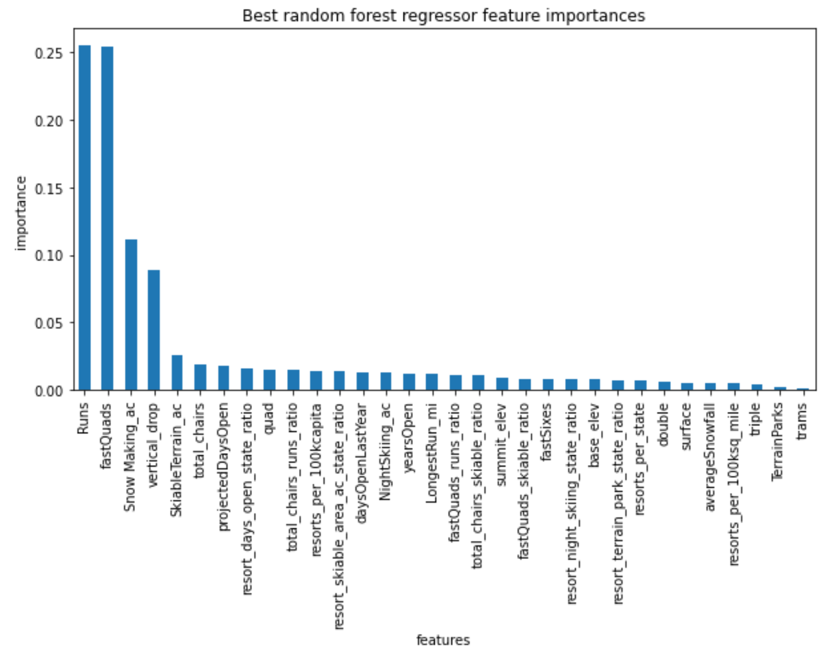
Best RF Model Analysis
Characteristics of the Best RF Regressor:
Imputation only with median
No scaling features
4 features recognized with the highest importance
Runs
fastQuads
Snow Making_ac
vertical_drop

Slide 8
Summary and Conclusion
Best RF Regressor with better performance selected as a final model
Focus on Runs and vertical_drop as the most important features in setting ticket price
Significant drop in ticket price if having more than 6 Runs closed
Pay particular attention to facilities like Snow Making_ac, fastQuades, total_chairs, LongestRun_mi, trams and SkiableTerrain_ac as important features
Ticket price sensivisity to their changes but not small changes
CV of Models on Train set | Mean of MAE | Std of MAE | Prediction of Models on Test set
Best RF Regressor | $9.80 | $1.47 | $9.42
Best OLS | $10.50 | $1.62 | $11.79

Slide 9
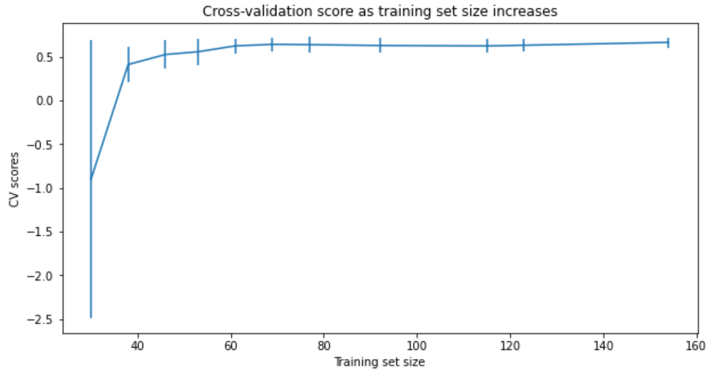
Data Quantity Assessment
70-30 train-test split
Make a pipeline to
Impute train and test set with median
StandardScaler each feature
Train simple linear regression model
Build learning on the pipe and train set with different fraction size
Result: No need to collect more data
No better scores when increasing the size of training sample more than 60

